Slide 1


Knowledge Representation is the Hardest Part of AI Boise State University
March 17th, 2021
Dan McCreary
Distinguished Engineer
Advanced Technology Collaborative
Notes:
Hi – my name is Dan McCreary. I am a Distinguished Engineer working in the Advanced Technology Collaborative. I am leading the graph technologies initiative within the Advanced Technology Collaborative. Our goal is to build a collaborative community the use graph technology to lower the cost of healthcare and give Optum a competitive advantage in the marketplace.

Slide 2
Talk Description
The key to Artificial Intelligence has always been the representation.
Jeff Hawkins
Title: Knowledge Representation is the Hardest Part of AI
Imagine going to the home page of Boise State University, and a chatbot pops up and asks you: "What would you like to learn today"? The chatbot is an AI that can recommend a course, an instructor, a group of your peers you can discuss a topic with, a chapter of a book, a Wikipedia page, a website, or even specific lines of code to help you debug a particular problem. How would you represent the knowledge base for this chatbot?
In this talk, we will discuss how AI systems like chatbots represent knowledge and how their learning recommendations are getting better quickly. We will review recent developments in AI, including deep learning, large language models (BERT and GPT-3), and what topic you will need to master to build a new generation of Cognitive Assistants.

Slide 3
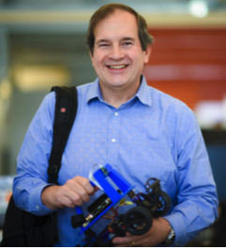
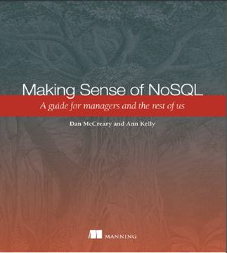
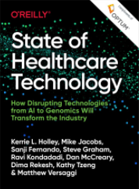
Hello, my name is
Dan
Distinguished Engineer at Optum Healthcare (330K employees and 32K technical staff)
Solution Architect focused on AI and teaching AI
CoderDojo volunteer (5 years)
IoT Hackday – LED costumes for girls coding clubs
$25 robots to teach computer science
Cofounder of AI Racing League
Co-author of "Making Sense of NoSQL" (w. Ann Kelly)
Co-author of State of Healthcare Technology
Interested in teaching methodologies and learning content recommendation systems

Slide 4



A Thought Experiment
What would you like to learn today?

Slide 5
I would like to learn how to write a chatbot
Yes
No
No
Great! I can help you. Do you know how to program in Python?
Are you familiar with Natural Language Processing?
Have you ever used a graph database before?
Thinking…here is your Lesson Plan: link

Slide 6
Questions to Consider for Education Technology?
How will AI impact education?
When will students prefer to interact with a Chatbot/AI (autonomous learning)?
What are the key milestones that will move us in this autonomous learning phase?
How will Natural Language Processing (NLP) technologies impact education?
What is the role of large language models (BERT and GPT-3)?
How do we train chatbots to recommend the appropriate content and services?

Slide 7
Three Circles of Experience
Machine Learning
Graph
Databases
Natural Language Processing

Slide 8
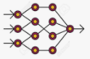
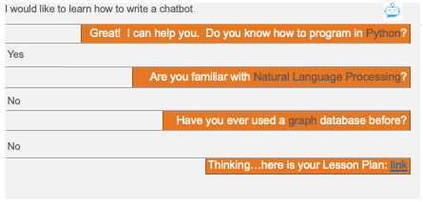
Typical Chatbot Architecture Today
Conversation Graph
Deep Neural Network
NLP
Engine
Intent Detection
1
2
3
Chat
History
4
5
Call
Service
Generate
Text
Incoming dialog is parsed by Natural Language Processing (NLP) system that pays attention to the key words in the text
The text is analyzed and linked to a conversation graph that holds the prior context of the chat and the new text
The conversation graph is analyzed, and the intent is predicted using a Deep Neural Network classifier that has been trained on prior chats
The key parameters are found in the chat, and the appropriate service (or services) are called
The result is converted to natural language text and returned to the user

Slide 9
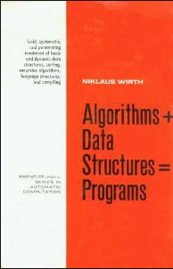
How do we represent connected knowledge?
Algorithms (Machine Learning) + Knowledge Graphs = AI

Slide 10
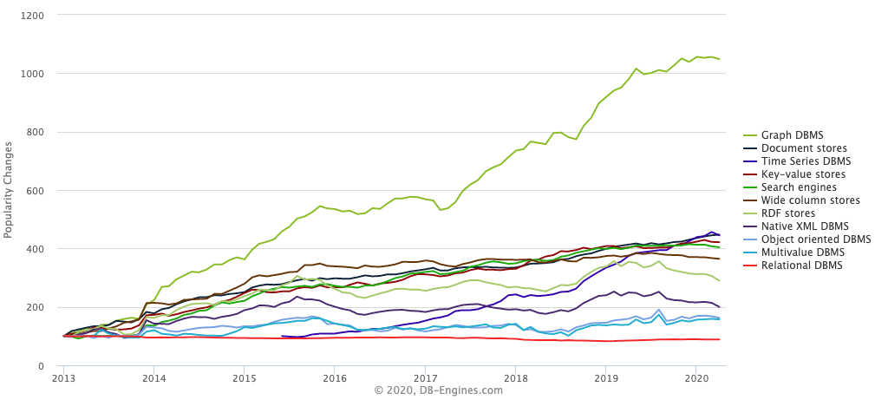
Graph Databases are HOT!
Graph Databases
https://db-engines.com/en/ranking_categories
Notes:
This chart shows the relative change in popularity of graph databases compared to other technologies according to DB Engines. DB Engines has web crawlers that regularly harvest an classify data related to databases. You can see that Graph Database popularity is the fasting growing database technology. This trend started in 2013 and it is continuing strong in 2018. Note that is is not absolute popularity. This is the change is popularity. Popularity also does not imply suitability. However, with these disclaimers aside you can clearly see a sustainable trend. Let’s see what other evidence we have about the rise of graph technologies.

Slide 11






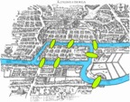
Graph Timeline
Google’s
Knowledge
Graph
“Things Not
Strings”
May 2012
Sir Tim’s
Vision Semantic
Web - RDF
2001
On
Intelligence
Knowledge
Representation
2005
W3C SPARQL
First Query
Standard
2008
Labeled
Property
Graph
Neo4j 1.0
2010
Optum
Healthcare
Graph
Sept. 2019
Euler Solves
7 Bridges of Königsberg
1736
TigerGraph
First True
Distributed LPG
2017
Distributed graphs scale!
Key insight: RDF is too brittle
Graphs Rise in Popularity
Key insight: Linked data

Slide 12
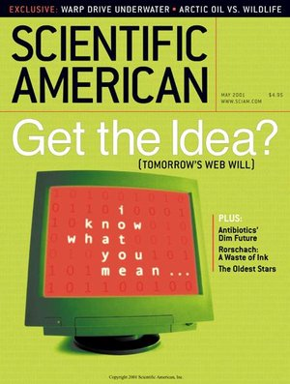
The Birth of the Semantic Web
May 2001
Resource Description Format - RDF
Keep it simple: Triples all the way down
Universal Identifiers: URIs
Ideal for data interchange
The problem: reification
When adding a simple attribute to a relationship causes 10,000 SPARQL queries to become obsolete
Property
Subject
Object

Slide 13
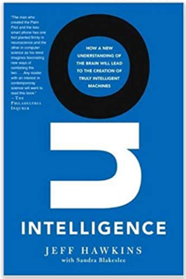
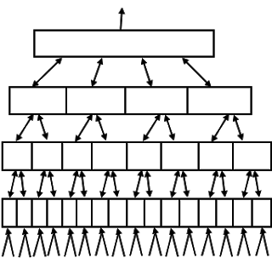
2005: On Intelligence
The key to Artificial Intelligence has always been the representation.
Jeff Hawkins
Abstract Concepts
Hierarchical Temporal Memory (HTM)
Edge Computing Converts Sensors into Concepts
Key insight: graph data models are an ideal way to represent knowledge
Sensory Data

Slide 14
2010 Neo4j 1.0 Released
Neo4j used a new graph data model called a Labeled Property Graph (LPG)
Each vertex and Edge had their own set of properties (key-value pairs)
Each edge must have a single type
Verticies can have 0-N types (labels)
Key insight: Adding a new property to a relationships does not require you to rewrite you queries! They solved the reification problem but kept the flexibility of graphs!
Properties
Properties
Properties
Vertex
Vertex
Edge

Slide 15
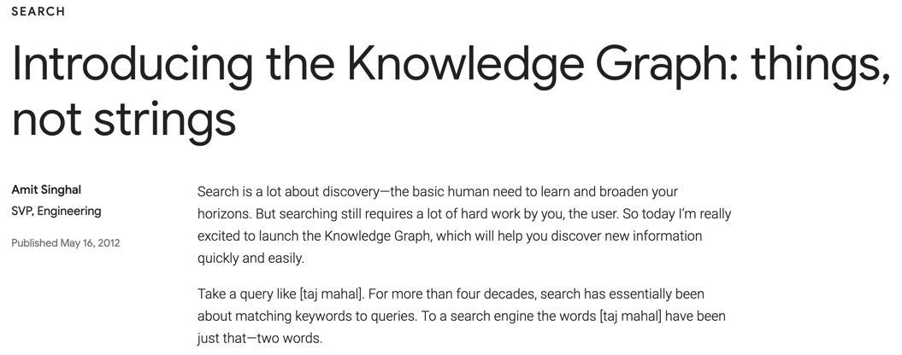
2012 Google Introduces the Knowledge Graph
Key Insight: Distributed graphs can scale and be highly available
Notes:
https://www.blog.google/products/search/introducing-knowledge-graph-things-not/

Slide 16
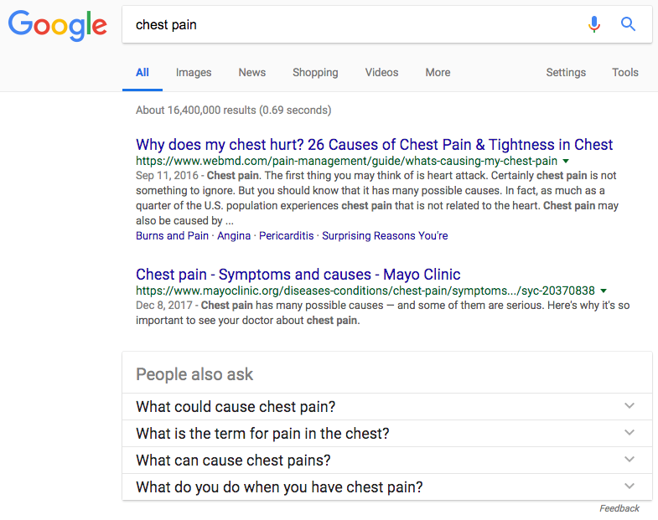
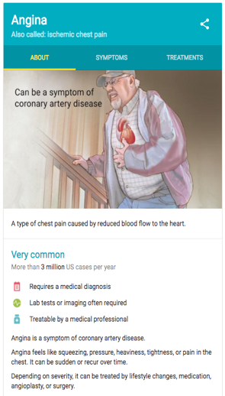
Google Knowledge Summary
Knowledge Graph
Summary
Angina
Chest Pain
Ischemic Chest Pain
About
Treatments
Symptoms
Notes:
If you go to Google and type “chest pain” you will note that a “Knowledge Summary” box appears in the right side. Note that the keyword is mapped into a Preferred Term called “Angina” – which is the formal medical condition name. You will also not that the term “Ischemic chest pain” is also shown as an alternate label. The Knowledge summary has tabs for ABOUT, SYMPTOMS and TREATMENTS. The summary box also indicates that this is a common condition that impacts over 3 million people per year in the US.
This is an example of using a Graph to group common concepts about a topic. The keyword gets you to the right part of the graph, but the knowledge summary is a machine generated summary that has been carefully reviewed for quality by the Mayo Clinic.
Googles Knowledge Graph contains over 100 billion “facts” about things that people search for. They build this graph by harvesting information from many web pages and using both Natural Language Processing (NLP) and machine learning based on what users actually click on to find the most relevant summary information for any topic in the graph.

Slide 17
Topics
A Thought Experiment
Thought experiment of chatbot that helps you learn
Concept and content data models
Reviewed progress in deep neural networks
Discussed the role of causal graph models (the why)
GPT-3 and General AI - May 28^{th,} 2020 - Open AI releases GPT-3 Paper
Massive 175B parameter deep neural network trained on text
First step into general AI
Discussion on Evolution of Online Learning
AI Stage Models
Capability Maturity Model – Six stages
AI Skill
What skills do we need to integrate AI technologies into our courses?
Notes:
This is a high-level agenda of what we want to cover in this session. We are going to start out with some external forces in the database market happening outside of Optum. We will focus on how companies in the Bay Area, like Google, Facebook and LinkedIn have created a competitive advantage using graph technology. We will then explain what a graph databases is and how it is different than a traditional relational database. Next we will discuss graph use cases in healthcare and some of the standards and vendors in the marketplace today. We will then wrap up with some issues around training and resource for you to learn more about graph technologies.

Slide 18
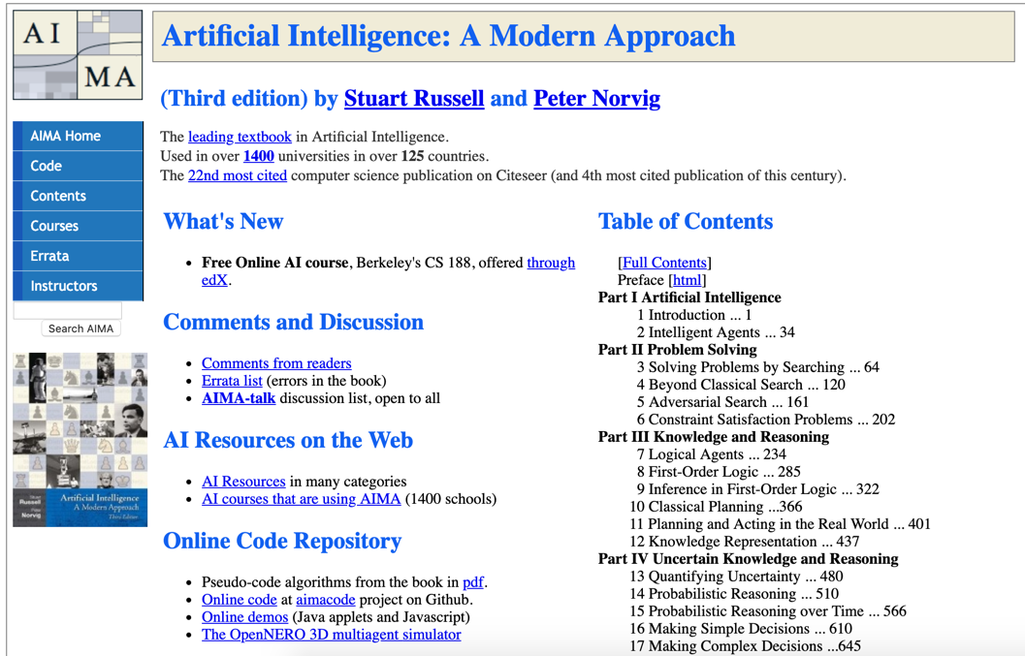
Notes:
http://aima.cs.berkeley.edu/

Slide 19
The World is “Not Only SQL” (a.k.a. NoSQL)
Relational
Analytical (OLAP)
Key-Value
key
value
key
value
key
value
key
value
Column-Family
Graph
Document
See Chapter 1: https://www.manning.com/books/making-sense-of-nosql
19
Notes:
OK, now lets take a step back and take a more structure look at where these tools fit into our business processes at Optum.
There are six main database architecture patterns we use when we think of a business problem.
Relational or row-stores
Analytical or OLAP
Key-Value stores – one of the simplest but most extensible data architectures
Column-family stores
Graph stores
and Document stores
Graph is just one of these six. Graph stores are often most closely related to document stores. Both Graph and document stores have the ability for new data to be added to structures without needing to remodel the data. We call these systems schema-free or schema agnostic. They are a key driver for highly agile systems.
Your systems may often draw on two or more of these systems. Databases that support multiple data models are called multi-model databases. They prevent us from having to store the same data over in multiple systems for transactions, search and analytics. Multi-modal systems that integrate graph technologies are also an emerging trend.

Slide 20

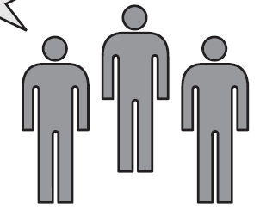
Role of the Solution Architect
Help!
Relational
Analytical (OLAP)
Key-Value
k
v
k
v
k
v
k
v
Column-Family
Graph
Document
Business Unit
Sally Solutions
Title: Solution Architect
Non-bias matching of business problem to the right data architecture before we begin looking at a specific products.
Notes:
Lets now take a look at the role of the solutions architect is to select the RIGHT data architecture based on the requirements of the business unit. Let’s call our main character Sally Solutions. When a business unit comes to Sally her job is to understand their high-level requirements and match the problem at hand to the right database architecture. Ideally she would do this before anyone starts to look at products.
The entire point of this session is to make sure we all understand when graph databases and graph technologies should be considered an option. Graph need to be one of the architectures considered.

Slide 21
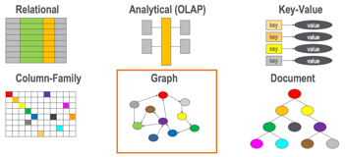
Graph Databases as an Architectural Approach
Business
Drivers
Quality
Attributes
User
Stories
Analysis
Architecture Plan
Architectural
Decisions
Tradeoffs
Impacts
Sensitivity
Points
Non-Risks
Risk Themes
Distilled info
Risks
We want all appropriate architecture options to be considered by Optum/UHC Solution Architects
Notes:
So how do the six options fit in? We want graph databases to be consider fairly along with existing legacy systems. Once you have a list of the options you can compare how hard it will be do do your critical user stores for each architecture. If a process is really easy in a graph but more difficult in a relational database you can see this in your analysis.
Although we will not go into the fine details of doing this analysis, called utility tree analysis, we want you to be aware of the process and be willing to bring in experts to help you use this process to objectively know when graph technologies should be used.

Slide 22
Definition: Graph Databases
A database that uses verticies (node) and edges (relationships) as atomic units of storage and where fast graph traversal is the primary method of accessing information.
Vertex
Vertex
EDGE
In graph databases, relationships are a primary consideration.
Notes:
Lets define what we mean by nodes and edges. Graph databases really have two fundamental units of storage: the vertex (or node) – which are usually the Nouns (People, Places and Things) and edges (or relationships) – which are the relationships between our vertecies. In some types of graphs, nodes and edges each can have their own properties. In graph databases, relationships are the primary consideration.

Slide 23
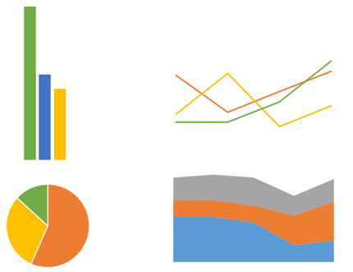
Charts vs. Graphs
Charts
Graphs
Charts are user interface elements
Graphs are data storage elements
Notes:
So just to be very clear, when we are talking about a graph databases, we are not talking about databases of charts and other UI elements. That is yet another use-case. We are talking about graph nodes and edges being the fundamental unit of storage in our system.

Slide 24
Note that a Graph Databases are Different from a Graphics Cards
Graph Database
Graphics - GPU Database
Focus on fast traversal of graph structures
Many systems (but not all) use index-free adjacency where no “lookups” are needed to find adjacent nodes in a graph
Graph query language is focused on graph traversal
Custom hardware provides for up to 1,000 billion traversal evaluations per second (GTEPS)
Examples: Neo4J, TigerGraph, StarDog, Janus Graph, AWS Neptune, Cray Graph Engine
Database that uses Graphics Processing Units to perform in-memory analytics
Focus on fast matrix manipulation via specialized hardware
GPUs can be used to increase graph traversal speeds and perform real-time analytics
GPUs are heavily used in AI and training Deep Learning networks
Example: KeneticaDB, MapD, SQREAM
Notes:
The word “Graph” itself is also very confusing because it is used to describe many similar gut distinct things. For many years we have been talking about video games that need specialized “Graphics Cards”. There is also an entire new generation of databases that use the inherent parallel nature of this hardware, called GPU for Graphics Processing Units to solve these problems. GPUs are specialized hardware devices that have been tuned to perform some parallel tasks, like rotating a video image or solving systems of simultaneous equations. Their core strength is fast matrix arithmetic.

Slide 25
Relational vs. Graph
Relational (row store)
Graph
ID
NAME
DATE
AMOUNT
Atomic unit of storage is a row of a table and data is appended to a table one row at a time
All columns within a table must have the same structure and no variations within a table are allowed
Table structures are fixed after design – all rows have the same structure
Relationship traversal is done via JOINs at runtime using log(N) search’s calculated at query time
Difficult to distribute over a cluster of 100+ nodes
Atomic unit of storage are nodes and edges
Each node and edge may have independent properties that are determined at run time (schema agnostic)
Joins between nodes and edges are computed at load time and are stored as memory pointers
Relationship traversal is done using pointer hopping – each core can evaluate 2M hops per second
Distributed graph products are new
Notes:
Now lets do a side-by-side comparison of both the traditional Relational row-store and compare some key facts. With a row store, the atomic unit of work is adding a single row at a time to a table. The key is that all the datatypes in each column must be the same. If there are dates in the third column and decimals in the fourth column all your data must conform to this standard. The table column structures and datatypes are fixed when you design your database. Once you have a million rows loaded into each table and 10,000 reports created it becomes challenging to modify the database.
Relational database also use the SQL language and they use join operations to dynamically calculate relationships each time the query is run. These calculations are based on binary search algorithms that run in log(N) time where N is the number of rows in each table. As the table grows the searches sale as the log of the number of rows.
Graph databases on the other hand allow you to add any number of nodes and and relationships into your graph database. Each node and relationship has it own properties but there are usually few overarching rules about what datatypes these structures can contain. Graph databases also used fixed memory pointers to store relationships between each node. As a result the queries over relationships are fast and there is no slow-down as the number of verticies gets bigger.

Slide 26
Example: Learning Embeddings Via Random Walk
Embedding: 200 32-bit integers
NLP technologies have shown us that we can create low-dimensional embeddings for every word by looking at the sequence of words in text.
Using Random Walk algorithms we can create a similar sequence of items to create embeddings for primary Vertices (Customer, Product etc.)
We can use these embeddings for 50 msec comparisons over 100M items if we do the calculations in parallel
Random Walks are very CPU intensive and require traversal of hundreds of millions of edges

Slide 27

Three Eras of Computing
1) Procedural Era
Data
Programs
Answers
Procedural Code (Rules)
Explanations (Why)
2) Machine Learning Era
Data
Machine
Learning
Rules (10M weights)
Answers
3) Graph Era
Data
Knowledge
Answers
Machine
Learning
Explanations (Why)

Slide 28
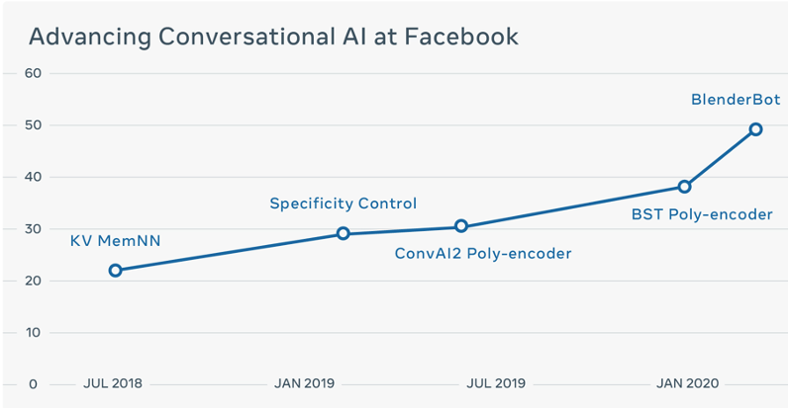
Incredible Gains in Chatbot Effectiveness in the Last 18 Months
Percent that prefer a chatbot over human
https://ai.facebook.com/blog/state-of-the-art-open-source-chatbot/
Notes:
https://ai.facebook.com/blog/state-of-the-art-open-source-chatbot

Slide 29
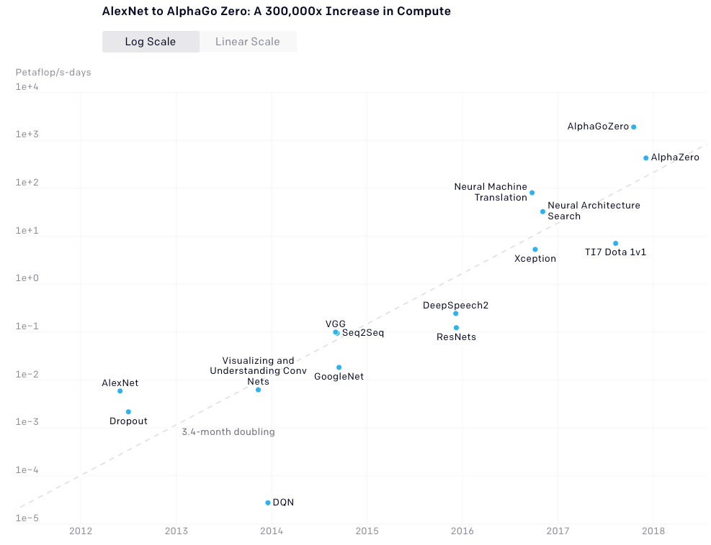
Power to Train Neural Networks Doubling Every 3-4 Months
300,000x Increase in Training Power
300,000x Increase in Training Power
Log scale:
2012
2018
https://openai.com/blog/ai-and-compute/

Slide 30
Neural Network – The Perceptron
A
P₁
P_{bias}
Output =
Step( A*P₁ +
B*P₂ +
C*P₃ +
P_{bias)}
P₂
B
+
Step Function
(Activation Function)
C
P₃
A simple model of a biological neuron
Inputs are multiplied by a parameter and summed together and sent to through a step function
The perception above has four parameters in the model
A parameter is a calculation in a neural network that applies a great or lesser weighting to some aspect of the data, to give that aspect greater or lesser prominence in the overall calculation of the data
Parameters give shape to the data and give the neural network a learned perspective on the data

Slide 31
Neural Network Parameter Counting Example
3 Input units (i=3)
5 Hidden units (h=5)
2 Output units (o=2)
1 bias unit in every non-input layer (b=7)
Count non-input layer nodes (5+2) = 7
Count these lines (3X5) = 15
Total Parameter count = 15 + 10 + 7 = 32
Count these lines (5X2) = 10
Deep neural networks take numbers in and send numbers out and there is no implicit meaning with any vertex
Notes:
https://towardsdatascience.com/counting-no-of-parameters-in-deep-learning-models-by-hand-8f1716241889

Slide 32
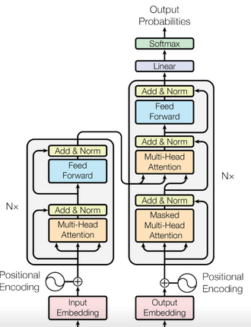
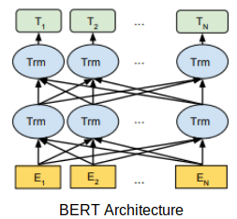
Unsupervised NLP Learning with BERT, Transformer and Attention
Creating a human labeled training set is very expensive
Transformer and Attention algorithms were created by BERT
Use “fill in the missing word” strategy to train our model
We all don’t need to know the details of how the models work
Notes:
Transformers: https://www.analyticsvidhya.com/blog/2019/06/understanding-transformers-nlp-state-of-the-art-models/

Slide 33
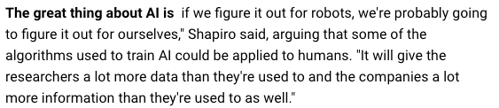
Demonstration of Generative Text
Prompt (bold)
Generated Text (not bold)
Example of a neural network that is trained on natural language text

Slide 34
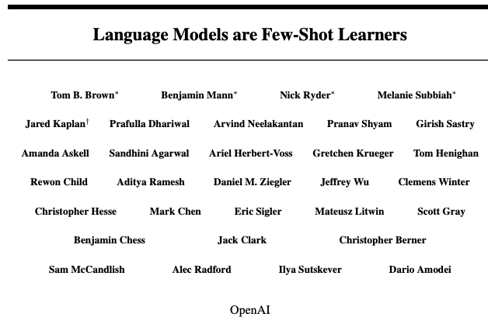
GPT-3 Paper
GPT = Generative Pretrained Transform
Submitted May 28th
175B parameter neural network model
Estimated $10M to train the model
Example of general AI

Slide 35
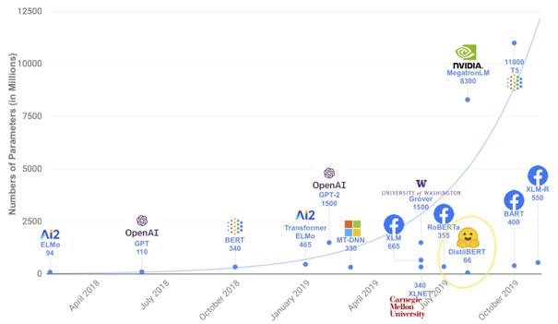
State of the art Speech / NLP models are large
GPT-3: 175B!!!
Huge datasets and infrastructure required for training
Source: “Energy and Policy Considerations for Deep Learning in NLP” - Strubell, Ganesh, McCallum - ACL 2019
Source: Thomas Wolf, INRIA ALMAnaCH

Slide 36

Speech & NLP Technologies are Evolving Quickly
2012-present Neural Networks & AI
Neural networks re-emerge as top machine-learning models, yielding state-of-the-art results across fields such as image, video, text and speech processing.
2007 Smart phone revolution
(e.g., Iphone & Android Platform) Powerful computers with robust sensor packages in the palm of the consumer’s hand Siri – first successful PA introduced in 2011
2020-GPT-3 Approaching human capabilities in many NLP benchmarks
2017-BERT Human accuracy & Cloud Google BERT, GPT-2, AWS Comprehend Medical, Google, Azure Cloud ASR are released
Mid 2010’s Smart Speakers 2014 Alexa introduced and sales 600 thousand units, growing to 54MM in 2019. In 2016 Google enters the SS market with Google Home. In 2017 Apple enters the market with Apple homepod
Mid 1990’s Task-specific Argument Extraction
(e.g., Nuance, SpeechWorks) User: “I want to fly from Boston to New York next week.”
Early 2000’s Intent Determination (e.g. Nuance’s EmilyTM, AT&T HMIHY) User: “Uh...we want to move...we want to change our phone line from this house to another house”
1990’s Keyword Spotting
System: “Please say collect, calling car, person or operator”
2020 Deep NLP systems surpass humans on the SuperGLUE benchmark consisting of 11 NLP tasks

Slide 37
Generative Pre-Trained (GPT) Models
A set of natural language processing deep neural network models that are created with unsupervised training on large amount of data.
GPTs are used to complete a sentence:
The great thing about AI is __________________
GPT-3 is so good at emulating human reasoning that the authors felt they were too dangerous to release.
https://openai.com/blog/better-language-models/

Slide 38
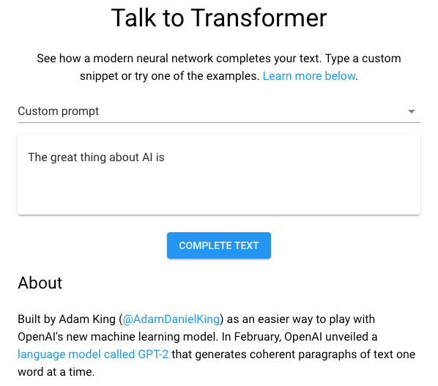
Demonstration: Talk to Transformer
No longer free
Paid API only
https://talktotransformer.com/

Slide 39
Sample NLP Questions from SuperGLUE
Prompt: My body cast a shadow over the grass.
Question: What’s the CAUSE for this?
Alternative 1: The sun was rising.
Alternative 2: The grass was cut.
https://w4ngatang.github.io/static/papers/superglue.pdf

Slide 40
Example of Prompting
“Shots” are the number of examples of correct results given to the model before the prompt is given
The learning done in the examples are not added to the model
https://arxiv.org/abs/2005.14165

Slide 41
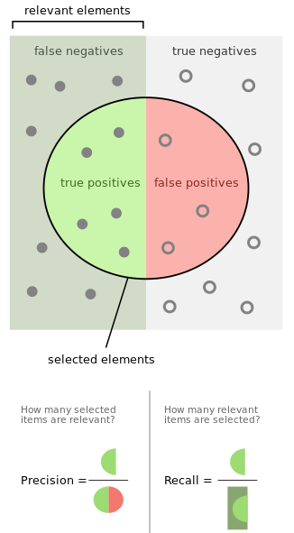
What is an F1 Measure?
How accurately do we answer the questions?
Do we get the question right in the first guess?
Precision * Recall
F₁ = 2 *
Precision + Recall
https://en.wikipedia.org/wiki/F1_score

Slide 42
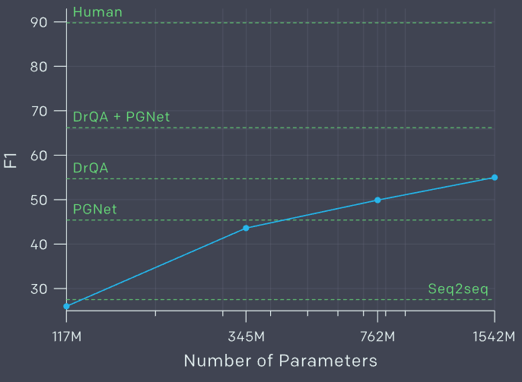
Sample F1 Measures (from 2019 GPT-2 paper)
As the number of parameters increase, the F1 measures of quality should also increase.
https://openai.com/blog/better-language-models/

Slide 43
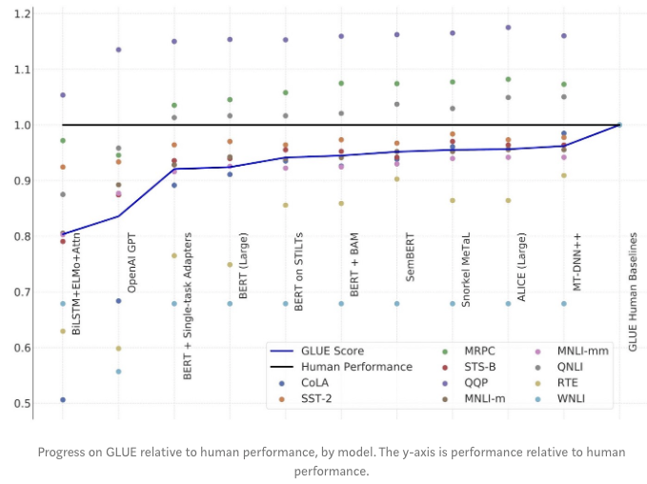
General Language Understanding Evaluation (GLUE) Benchmarks

Slide 44
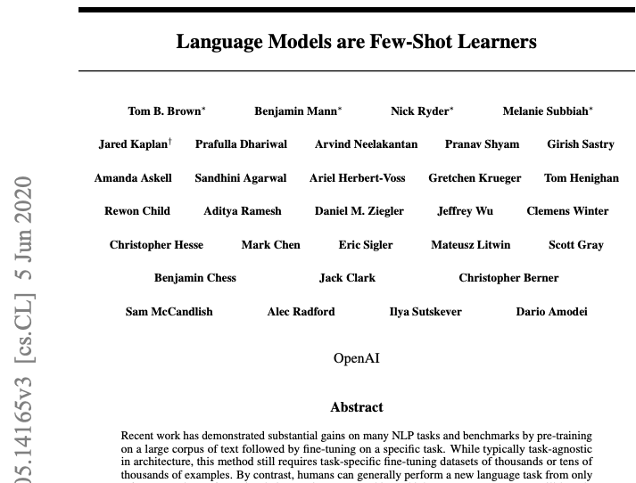
Open AI GPT-3 Paper
June 2020 Paper from OpenAI
Massive model 170B parameters. 100x larger than GPT-2
Built on custom hardware supplied by Microsoft
Highest scores ever on a wide collection of NLP benchmarks
Comparable to specialized task-specific state-of-the-art models
https://arxiv.org/abs/2005.14165

Slide 45
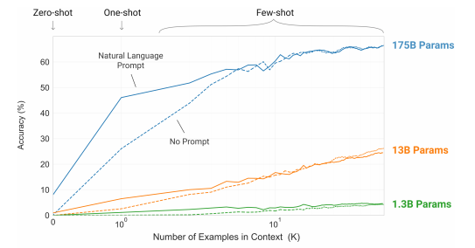
Accuracy vs. Context Examples
Results: The more context examples the higher the accuracy.

Slide 46

Guessing the Real Article
Real Article Written by Human
Fake Article
Written by GPT-3
Which one is real?
Correct answer 52% of the time.
Human Test Subject
To evaluate the model on a news-article generation task, the team used Amazon Mechanical Turk to hire human judges to guess which of a pair of articles was real and which was generated by GPT-3. Humans chose the real article only 52% of the time; in essence, humans were no better than a coin-flip at choosing the real article.

Slide 47
Positive Ways to Use High-Quality Language Models
AI writing assistants
More capable dialogue agents
Unsupervised translation between languages
Better speech recognition systems

Slide 48
Measuring Complexity in Graphs and Networks
The human brain has 82B neurons
Each neurons has 10,000 connections (degree of graph)
Equivalent is 100T parameters
Human brains are not the same as neural networks or graph databases, but they all use similar metrics to count complexity
GPT-2 has 1.5B parameters
GPT-3 has 175B parameters

Slide 49
Key Questions
What are the key stages of online learning?
What data and AI skills do I need to help schools move online?
What are the challenges of learning today?
What are knowledge spaces?
How can technology make learning easier?
What is adaptive learning?
How can recommendation engines help?
How will NLP and intelligent agents transform education?

Slide 50
Six Levels of Self-Driving Cars
Level 0: The automated system issues warnings and may momentarily intervene but has no sustained vehicle control.
Level 1 ("hands on"): The driver and the automated system share control of the vehicle
Level 2 ("hands off"): The automated system takes full control of the vehicle: accelerating, braking, and steering
Level 3 ("eyes off"): The driver can safely turn their attention away from the driving tasks
Level 4 ("mind off"): As level 3, but no driver attention is ever required for safety, e.g. the driver may safely go to sleep or leave the driver's seat
Level 5 ("steering wheel optional"): No human intervention is required at all on all roads all over the world, all year around, in all weather conditions
https://en.wikipedia.org/wiki/Self-driving_car#Classification

Slide 51
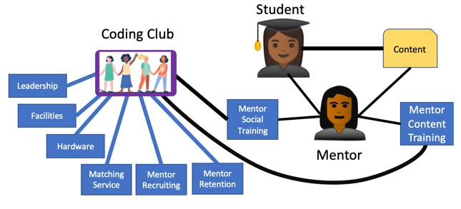
Can we predict student success?
Student success data model:
Predictive function:
Predicting student success

Slide 52
Evolution of Online Learning
Autonomous
AI-Learning
Optimized
AI-Agent
Predictable
Recommendation-Driven
Defined
Concept-Driven
Managed
Coordinated
Initial
Formative
A capability-maturity model for online mentoring
https://medium.com/@dmccreary/how-online-coding-clubs-will-transform-education-550faccff1f
Notes:
https://medium.com/@dmccreary/how-online-coding-clubs-will-transform-education-550faccff1f

Slide 53
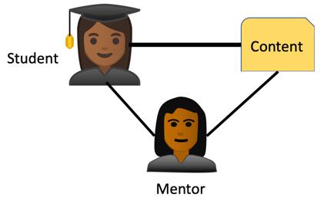
Level 1: Initial Formative Online Learning
Autonomous
AI-Learning
Learning Goals:
Scratch
Python
Robots
Optimized
AI-Agent
Predictable
Recommendation
Driven
Mentoring Experience:
Java
Python
Web
Defined
Concept-Driven
Online training with mentors
Use Zoom to work with students
Manual matching of a student’s preferences with a mentor’s background
Assignments given and reviewed by mentors
Managed
Coordinated
Initial
Formative

Slide 54
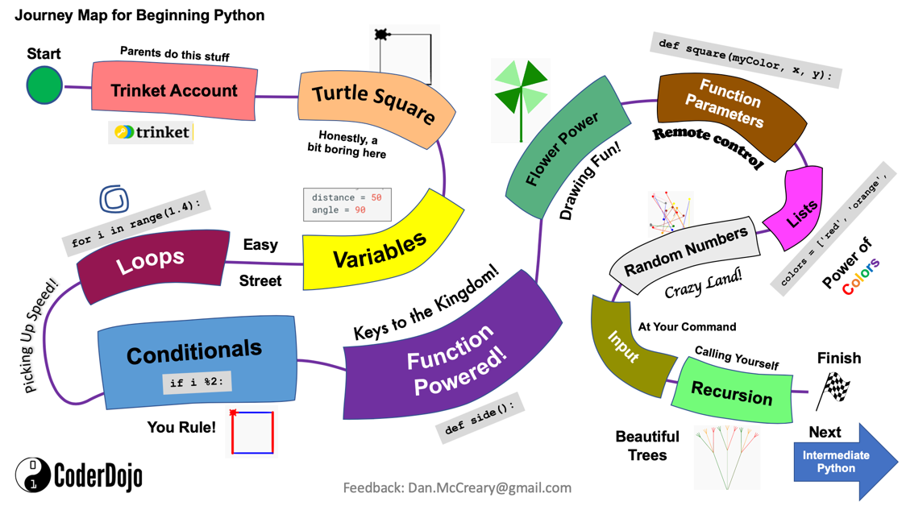

Slide 55
Level 2: Managed Coordinated
Autonomous
AI-Learning
We recommend that Alice has a mentoring session with Lisa on Robots.
S
M
S
M
Optimized
AI-Agent
S
M
Predictable
Recommendation
Driven
Students
Mentors
T
T
Defined
Concept-Driven
T
Topics
Managed
Coordinated
Many student interests, many mentors, many topics
Sophisticated matching process based on constraint optimization algorithm
Successful outcomes tracked and used for future student-mentor matching
Initial
Formative

Slide 56

Level 3: Defined Concept Driven Learning
Ready to Learn Concepts
Student
Learning Goals
Autonomous
AI-Learning
Known Concepts Graph
Optimized
AI-Agent
Predictable
Recommendation
Driven
Learning
Content
Lesson
Defined
Concept-Driven
Mentor
Concept graphs created for both students and mentors
Students express their learning goal concepts - the concepts they want master, and we track what contents they need to learn to
Manual processes and simple deterministic rules match content with mentors
Managed
Coordinated
Initial
Formative

Slide 57

Level 4: Predictable Recommendation Driven
Autonomous
AI-Learning
Known Concepts
Ready to Learn
Goal Concepts
Optimized
AI-Agent
Predicted best matches
AI Agent
Predictable
Recommendation
Driven
Learning
Content
Lesson
Defined
Concept-Driven
Mentor
Managed
Coordinated
We have a large a stable graph database of our concept, their dependencies, our students, their goals, and their existing knowledge
We use machine learning to match content and mentors
Initial
Formative

Slide 58

Level 5: Optimized AI-Agent Driven
Autonomous
AI-Learning
I can’t figure out this problem!
Try using the debugger and look at the index value on line 25
I am here if you need me
Optimized
AI-Agent
Predictable
Recommendation
Driven
Defined
Concept-Driven
Student
Agent
Mentor
Managed
Coordinated
Introduction of AI-backed chatbots for narrow domain problems
Trained on learning management clickstream data and question/answer pairs of millions of learning sessions
Human mentors added when needed
See: Open AI’s GPT-3
Initial
Formative

Slide 59
Level 6: Fully Autonomous AI-Learning Agent Clubs
Autonomous
AI-Learning
Optimized
AI-Agent
Predictable
Recommendation
Driven
Defined
Concept-Driven
An extensive and well-connected knowledge graph that is used to train an online learning agent
Learning agent has access to all concept graphs, content, and access to billions of chats between students and mentors
Strong general AI capabilities
The agents will understand common sense and are responsive to the individual needs of students down to recommending specific slides in a presentation, particular fragments of code, and even suggest particular discussion topics with mentors or other students (with mutual consent)
Managed
Coordinated
Initial
Formative

Slide 60
Role of Teacher and Mentor
Weight on
Student
Success
Level 0
Level 1
Level 2
Level 3
Level 4
Level 5
The relevance of the teacher and mentor in predicting student success will drop as the automation increases

Slide 61
Challenges
Putting reusable online content online is hard
GitHub Pages
Markdown
Mkdocs
Material web components
Access to private student information
Student records privacy and portability between computer systems
Who will rate online content?
Will learning content ratings be manipulated by pollical processes?

Slide 62
Positive Impact for Society
Wikipedia model: free to everyone
Lower cost of education
Learning should be offered free – just like public schools and public libraries
Everyone will have equal access to high-quality education

Slide 63
Skills Necessary
Data Literacy – how to find and analyze large datasets for training AI models
Data Science – probability and statistics, linear algebra
Python and Jupyter Notebooks – modern stack
Machine Learning – PyTorch and TensorFlow
Data Structures – graph and distributed graph
Knowledge representation – Labeled Property Graph
Web and user experience – changes every 18 months
React and Google Material components

Slide 64
Content Licensing Information is Creating Commons BY-NC-SA 3.0
You are free to use all the materials in this presentation with the following conditions:
Attribution — You must give appropriate credit, provide a link to the license, and indicate if changes were made. You may do so in any reasonable manner, but not in any way that suggests the licensor endorses you or your use.
NonCommercial — You may not use the material for commercial purposes.
ShareAlike — If you remix, transform, or build upon the material, you must distribute your contributions under the same license as the original.
Attribution – NonCommercial - ShareAlike 3.0 (CC BY-NC-SA 3.0)
https://creativecommons.org/licenses/by-nc-sa/3.0/

Slide 65



Dan.McCreary@optum.com
https://medium.com/@dmccreary
https://www.linkedin.com/in/danmccreary/
@dmccreary

